Slide 1
(Some aspects of) the future of AI
Tuomas Sandholm

Slide 2
Some say AI has only been successful in specific applications with highly application-specific techniques
I don’t mind too much
Not true
Application
Narrow waist is desirable
Reasoning
technology

Slide 3
Don’t make the waist too narrow!
Use data if it exists (priors / extra inputs)
Unlike in some current practice and in competitive analysis of algorithms
E.g., revenue-maximizing or cost-minimizing auction/pricing design
  Wilson doctrine versus automated mechanism design
    Combinatorial auctions
    Sponsored search
E.g., sample-trajectory-based online algorithms for kidney exchange

Slide 4
Core AI in core AI
E.g., tree search in
  Bayesian reasoning (e.g., via #SAT)
  Clustering
  Task/resource allocation via combinatorial auctions

Slide 5
Tree search ≈ integer programming
AI and operations research communities
  Didn’t communicate enough
    Re-invented some things, e.g., A*
  Focus on different aspects
  Now, cross-fertilization

Slide 6
Current outside-the-box tree search approaches in my lab
Motivations
  Good branching is hard in practice and theory – so much so that random restarts help
  DPLL might be too weak a proof system
Search tree restructuring on the fly [Zawadzky & Sandholm 2010]
Combining DPLL and resolution in the tree
Formula learning
Treeless tree search [Dickerson & Sandholm SoCS-13]

Slide 7
What does NP-hardness mean, really?
That problem is intractable in practice? No!
  Scalable complete SAT solvers since late 90s
  Scalable general-purpose integer programming since early 90s
    Interesting similarity in breakthroughs
  Scalable combinatorial auction winner determination since 02
    E.g., 2M bids, 85,000 items (multiple units of each)
Nothing? No!
One important meaning: NP-hardness limits knowledge.
There is no concise full characterization of how answer depends on inputs
  E.g., manually trying to derive revenue-maximizing multi-item auctions is futile => automated design per setting

Slide 8
Highly parallel / distributed
Driving trends
  Moore’s law ended 2004 => to continue progress, need highly multi-core
  Software-as-a-Service & clouds
    Access to large-scale resources
    Affordable due to amortization across bursty users
  Big data
How should AI algorithms be adapted to best use these resources?
  Search
    Branch parallelism versus
    Different branching orders / questions versus
    Complete & incomplete versus
    Solution improver & optimality prover versus
    ?
  Convex optimization, …

Slide 9
Thoughts about goals of AI
AI has many different goals
  This is nothing to avoid
  E.g., OR has same “problem” and is not shy about it
Shouldn’t define AI as that which still cannot be done
Human-level intelligence just a milestone along the way
Many AI goals include game-theoretic reasoning

Slide 10
Potential new applications with huge positive impact on the world
Better electricity markets
Combinatorial CO₂ allowance / pollution credit markets
Automated market making
Campaign market for advertising
Security games
  Physical, information, malware protection, …
  Sequential

Slide 11
AI in medicine (and biology)
Machine learning from data
  E.g., DNA sequencing data will be driving this
  Active learning
AI not just for understanding but for control…

Slide 12
One Exciting Future Application of AI Control in Medicine/Biology:
Computational Game Theory and Opponent Exploitation to Direct Evolution and Adaptation

Slide 13
Vision
[Sandholm, AAAI Conference on Artificial Intelligence, 2015; patent pending 2012]
Living organisms evolve/adapt to challenges
=> key difficulty in developing therapies since challenged organisms develop resistance
Idea: harness evolution/adaptation strategically for therapeutic/technological/scientific goals
Model this as a 2-player 0-sum incomplete-information game between treater and opponent
A strategy (multi-step contingent plan) is computed for the specific game at hand
0.3
0.2
0.5
Information set
0.5
0.5
Notes:
Techniques for complete-info games do not apply.

Slide 14
Game-theoretic approach is safe
…but sometimes too conservative…

Slide 15
Opponent modeling & exploitation
Start playing game theoretically. Adjust toward exploiting opponent in points of the game where good data about opponent’s play has been amassed [Ganzfried & Sandholm AAMAS-11]
Best response (stochastic optimization) -> trajectory-based optimization, policy gradient, algorithms for partially-observable Markov decision problems, …
Safe opponent exploitation [Ganzfried & Sandholm EC-12, TEAC-2015]
Evolution and biological adaptation are myopic => can trap it
  Trap → multiple traps → minimize opponents’ expected utility
  Recently started studying complexity and algorithms for this [Kroer & Sandholm IJCAI-15]
Notes:
For POMDPs w black-box simulator: POMCP [Silver and Veness, 2010] or DESPOT [Somani et al., 2013]

Slide 16
Benefits
Most medical treatment today is myopic
=> Puts treater at same disadvantage that opponent has
Algorithms can often solve games better than humans
Speed & automation => custom plans
Potential to guide medical research
Notes:
Most valuable knowledge to generate is knowledge that enhances the value of the treatment plans most
=> Active learning.

Slide 17
Categories of Application of steering evolution/adaptation

Slide 18
Battling disease within an individual patient
(viruses, bacteria, cancer, etc., in animals & plants)
E.g., opponent = HIV
Opponent’s actions include evolving the virus pool within patient
Treater’s actions include treatments (e.g., drug cocktails) and tests
  Could even include de novo drugs from large/infinite space
    A model can be used to predict how well each of the drugs in the cocktails would bind to each mutation at each site
Wild potential longer-term directions:
  Tattoo sensors that measure state, which affects next action in the plan
  Compiling the plan into DNA cages or hybridization-based logic
Notes:
There’s data
What locations are most typical mutation sites and what the most typical mutations at each site are.
(Treatment outcomes for
different segments of patient population)
Chemical biologist Marcel is building dataset for cancer: if you kill this set of cells, what happens to each other cell type. (Method: cybersort)
Tattoo sensors: Marcel. Read out cytokine signaling.
DNA cages: Danith Ly & Bruce Armitage.

Slide 19
Battling disease in patient population
E.g., opponent = pandemic
Actions of disease at any point in the game:
  Spread of various strands and mutations to different regions/population segments
Actions of treater at any point in the game:
  Which drug/cocktail/quaranteening/tests to use in which part of the population

Slide 20
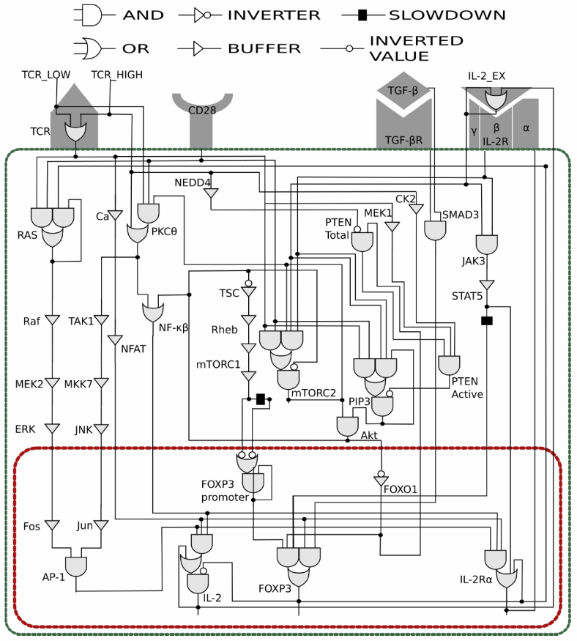
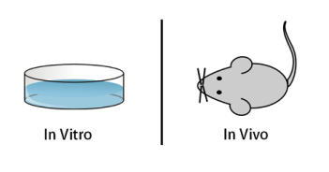


Steering a patient’s own immune system
[Kroer & Sandholm IJCAI-16]
“Opponent” = one’s own T cell population
Tune it to fight autoimmune diabetes, cancer, IBD, infection, allergies, …
Actions of treater at any point in the game:
  Block cytokine receptor signaling
  Add or remove cytokines
  Alter transcription factor expression
  Reversible antisense translational repression
  Can be done in combinations and for different durations
[Miskov-Zivanov et al. 2013; Hawse et al. 2015]
2⁵⁹ states
Plan
Notes:
Multiple feedback loops that work at different rates.
Penny
Multiple diseases will be tackled, as I’d be happy to discuss in the Q&A.

Slide 21
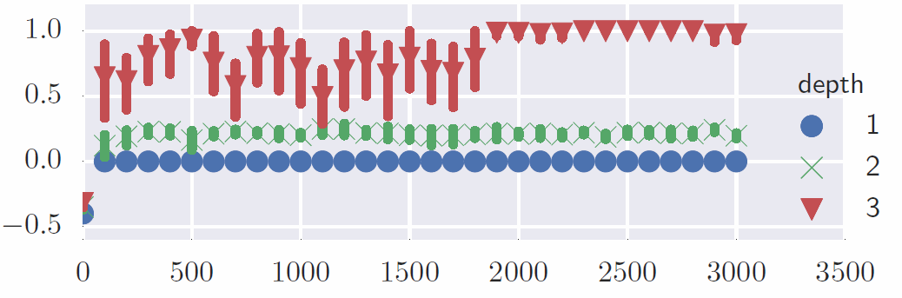
Results (in silico) of generating regulatory T cells
Expected
value
of the
plan
Iterations of our planning algorithm
Notes:
Explain k-step plan

Slide 22
High-level summary
AI planning (UCT in this case) to construct a sequential treatment plan
  Calls an off-the-shelf biological simulation tool as the opponent model
    A leading T cell simulator [Hawse et al. 2015] available in BioNetGen
Two alternate goals:
  Developing regulatory T cells (prevents autoimmune disease)
  Developing effector T cells (helps cancer survival)
Conclusions:
  Current pathway models and simulators suffice to support beneficial treatment planning
  Sequential treatment plans are significantly better

Slide 23
Action choices (in the experiment) whenever we can act
Any combination of:
  TCR: high/low/none
  CD28: high/low/none
  TGFβ: activate/inhibit/none
  IL-2: activate/inhibit/none

Slide 24
State measurement (abstraction)
Values of two proteins: FOXP3 and IL-2
Chosen because they are relevant to the value function for both types of cells that we consider
Measuring state of additional proteins may lead to even more interesting results

Slide 25
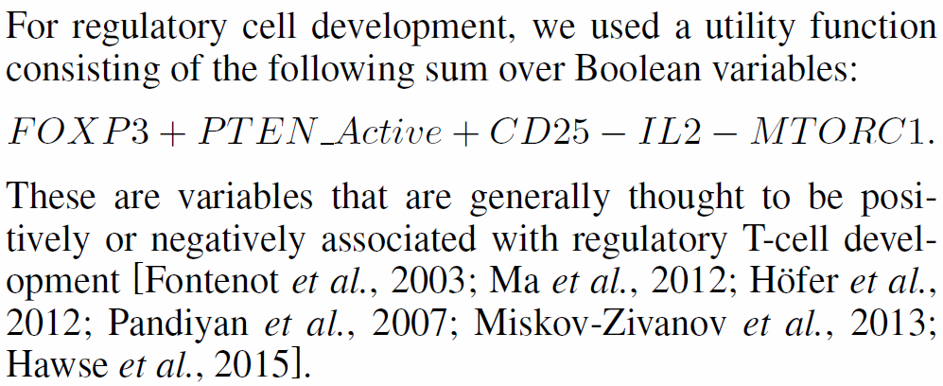
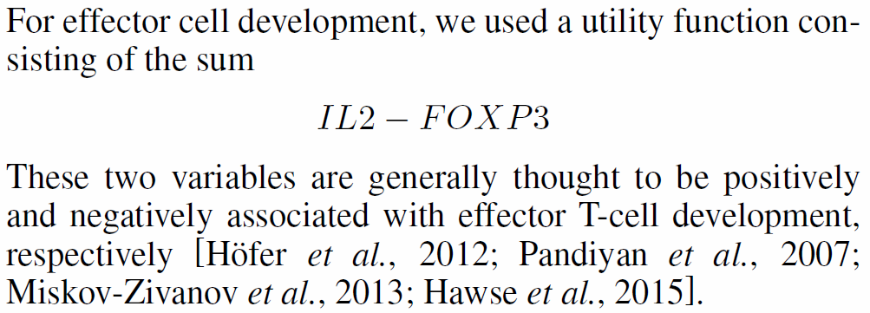
Utility functions for planning
Regulatory cells experiment:
Effector cells experiment:

Slide 26
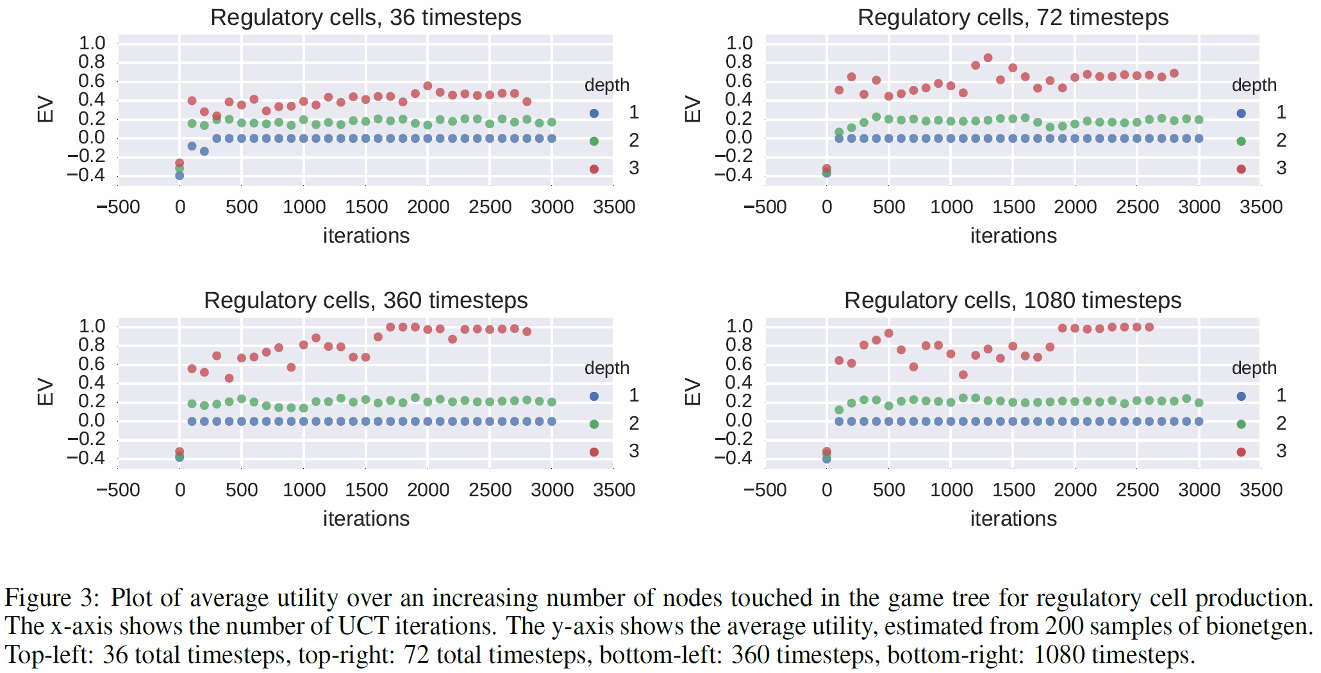
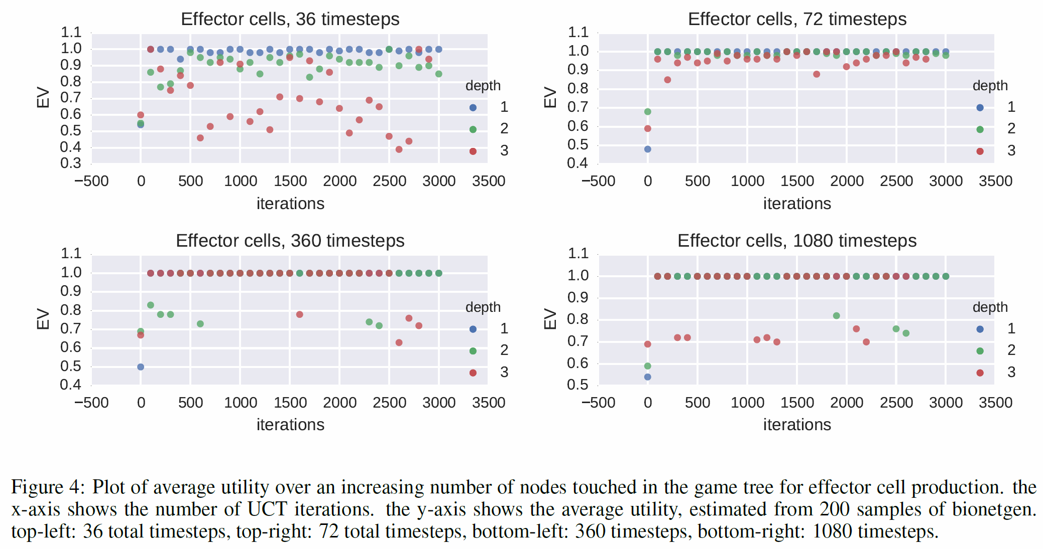
Experimental results

Slide 27
Applications beyond battling diseases
Cell population differentiation or even repurposing
  Could one evolve
    a blood cell into a liver cell
    a cancer cell (e.g., T47D) into an M1 macrophage
    …
  Could one grow a missing organ or limb?
Synthetic biology
  Evolve bacteria that eat toxins or biofilms without introducing foreign genetic material

Slide 28
Tackling questions in natural science
Enables one to formalize and potentially answer fundamental questions in natural science
  Can a certain kind of cell be transformed into a certain other kind of cell using evolutionary pressures using a given set of manipulations and measurements?
  How much more power do multi-step treatment plans offer?
  Does there exist a strategy that will destroy a given diverse cell population (e.g., cancer) in a way that leaves no persistors?
What is inherently (im)possible to achieve via adaptation? Via evolution?

Slide 29
Another Exciting Application of AI Control in Medicine:
Kidney Exchange

Slide 30
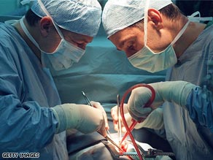
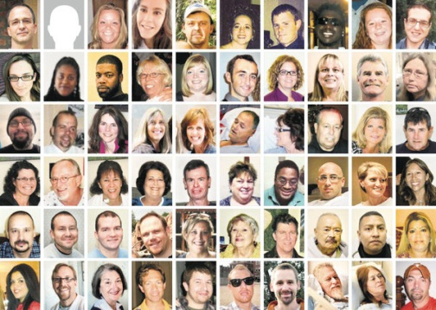
Kidney exchange
My algorithms & software run the UNOS nationwide kidney exchange
  Selected in 2008; exchange went live 2010; now has 153 transplant centers
I have also conducted match runs for private kidney exchanges
Our ideas fielded worldwide
  E.g., never-ending chains, which lead to ~600 transplants per year in US alone
Notes:
“My vision is that in the long run, I will actually field the work I discussed today into widespread practice.
In several other strands of research that I do, I have already proven that I can develop new CS algorithms and field them broadly into the world.
One example is kidney exchange.”

Slide 31
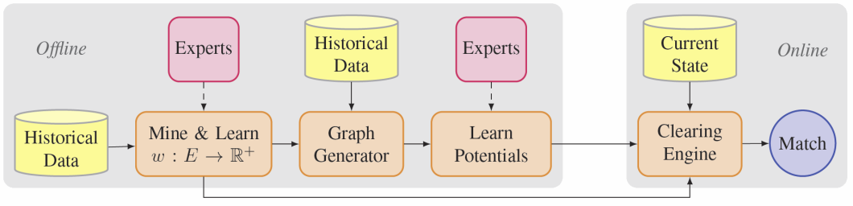

Some of our current research on organ exchanges
Even faster batch optimization algorithms, esp. with chains [AAAI-16, EC-16 submission, …]
Dynamic matching [IJCAI-09, AAMAS-12, AAAI-12, AAAI-15]
Failure-aware matching [EC-13, AAAI-15]
Learning a better policy [AAAI-15]
Better edge testing policies [EC-15, …]
Using multiple donors from one recipient
International
Liver lobe and cross-organ exchanges [AAAI-14, JAIR-16]

Slide 32
Summary
AI is an exciting area because we can directly make the world a better place
Narrow waist => general-purpose reasoning engines
  Lots of people improve the engines
But don’t make waist too narrow (e.g., use data)
Lots of research to do on search, convex opt, etc.
Parallel / distributed
New potential applications to change the world

